Slide 1
IOT Based Solar Power Monitoring System

Slide 2

A Project Phase-1 Presentation on
“IOT BASED SOLAR POWER MONITORING SYSTEM”
Presented by
GAURI R CHOPADE - B11
RUSHIKESH D GIRI - B18
AKASH B KARRE - B31
AISHWARYA D MANTHALKAR - B39
Under the guidance of
Prof. A.V. SHIVASHIMPI
Department of Electrical Engineering
A.Y. 2022-23 Sem-I

Slide 3
Contents
Introduction
Problem Statement
Objectives
Literature Review
Block Diagram
Proposed System
System Requirements
Advantages
Applications
Conclusion
References

Slide 4
Introduction
The internet of things is a futuristic technology by which an object could be sensed, monitored and controlled remotely using the cloud server network.
By using this technology machines can communicate with themselves and be controlled without requiring humans.
An IOT Based Solar Power Monitoring system monitors the Solar panel parameters like voltage current and power generated over a Web server using internet and the solar panel detects sunlight using LDR so that it can get positioned where it receives maximum sunlight, due to this solar panel can operate at its maximum efficiency all day.

Slide 5
Problem Statement
Solar power has become very trendy as it is available in abundance and solar power generation is also cheaper in the conversion technology.
In this technology the light energy is converted into electrical energy which is known as photovoltaic effect and this is called solar energy.
By using solar power, the pollution will be reduced and by monitoring it the energy forecasting, households and communities, the productivity can also be enlarged.
By monitoring this system, we can know the status of it and also shows when there is a problem which is so helpful.

Slide 6
Objectives
The main objective is to monitor the power of the system using sensors sensed by Arduino. The monitor of the solar energy system shows the power and energy usage. This system helps to implement in smart grid for efficient usage.

Slide 7
Literature Review
The development of monitoring online and the control of system is based on android platform by Bluetooth interface of mobile phone As a communication link it creates data exchange with the hardware of power conditioning unit, with the help sensing circuits the value of Current and the voltage measurement of the renewable source is processed by the micro controller of the microchip. Then the parameter are Sent to the personal computer over USB and the system is observed instantly. The system is monitored daily, weekly and monthly.
Goto, Yeshihiro,has explained that the integrated system that monitors and manages the has developed and it has started operation. The System can operate and maintain above 200,000 telecommunication power plants, which includes inverters, rectifiers and air conditioning Plants, is installed above 8000 buildings to improve the user interface which use the communication technologies and the information of Feature system and it integrate management and remote monitoring functions into single system.

Slide 8
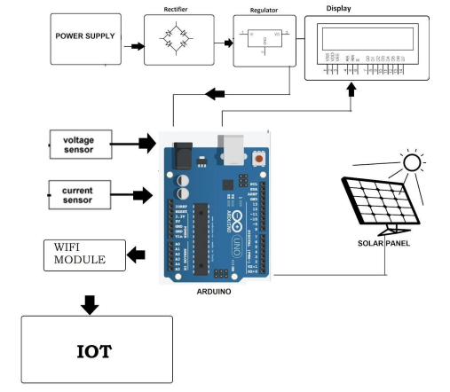
Block Diagram

Slide 9
Proposed System
The main intention of this proposed project is to get maximum power output from the solar panels.
Additionally, if there is any improper functioning of the solar panels will be shown and also the parameters like voltage and current are monitored by using the sensors and displayed by using the IoT technology.
This model is explained by using the solar radiation i.e., sunlight from the sun is trapped by the solar panels and then these solar panels capture sunlight and turn into useful energy forms of energy such as heat and electricity.
Then the obtained electrical energy is sensed by the sensors such as voltage sensor sense the voltage generated by the solar panel with the help of voltage divider principle and current is obtained by using mathematical formulation.

Slide 10
System Requirements
Hardware Requirements
ATMEGA 328
Solar panel
Regulator power supply
Wi-Fi module-ESP8266
Voltage sensor
Current sensor
LCD (Liquid Crystal Display)

Slide 11
System Requirements
Software Requirements
Arduino IDE
Embedded C

Slide 12
Advantages
Enables the efficient use of renewable energy.
Environment Free.
Requires the little maintenance for their application.
Cost Effective.

Slide 13
Applications
Educational Institutions
Industrial Applications
Residential Applications

Slide 14
Conclusion
The proposed system stores the voltage and current parameters and keeps updating the new values. By tracking the solar photovoltaic system continuously, the daily or monthly analysis also becomes simple and easy. It is also possible to detect any errors occurring in the system if there is any uncertainty in the generated data by tracking the solar panels that are operated at the maximum capability.

Slide 15
References
[1] Shailesh Sarswat, Indresh Yadav and Sanjay Kumar Maurya 2019 Real Time Monitoring of Solar PV Parameter Using IoT 9 p 267
[2] R.L.R. Lokesh Babu, D Rambabu, A. Rajesh Naidu, R. D. Prasad and P. Gopi Krishna 2018 IoT Enabled Solar Power Monitoring System Int. J. Eng. & Tech. 7 p 526
[3] R. Vignesh and A. Samydurai 2017 Automatic Monitoring and Lifetime Detection of Solar Panels Using Internet of ThingsInt. J. Inn. Res. in Comp. and Comm. Eng. 5 p 7014
[4] Subhasri. G and Jeyalakshmi. C 2018 A Study of IoT based Solar Panel Tracking System Adv. In Comp. Sci. Tech. 11 p. 537
[5] Ankit Kekre and Suresh K. Gawre 2017 Solar Photovoltaic Remote Monitoring System Using IoT Int. Conf. on Recent Innovations in Signal processing and Embedded Systems (RISE) (Bhopal, India) p 27

